Slide 1
Sharethought

Slide 2
Features
Chat Function
Users will chat with each tag match
Geofencing User Boundaries
Users will have set circular boundaries where intersections will occur
Tagging Topics
User defined topics and tags will allow users to walk by each other and tag other users based on matching topics and locations
Friends List
Maintain contacts with people for future communication

Slide 3
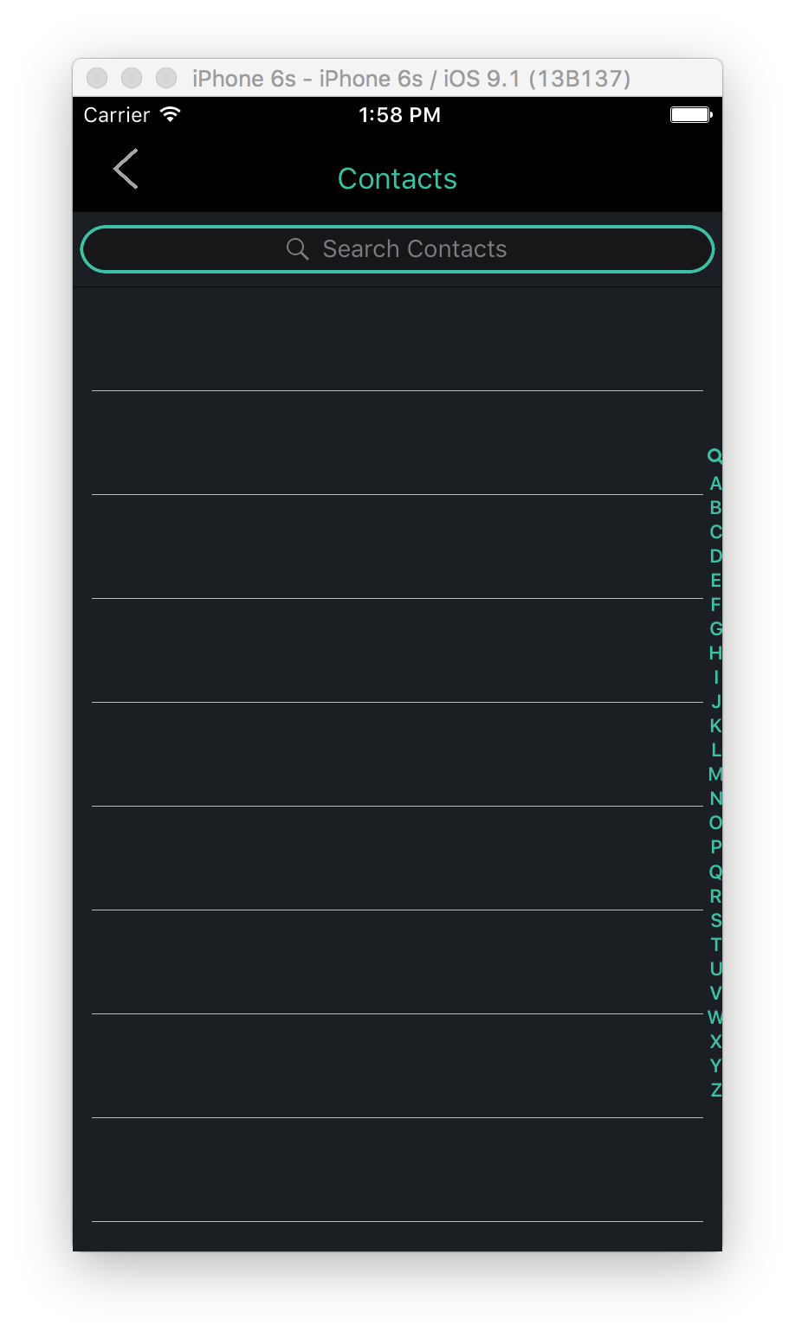
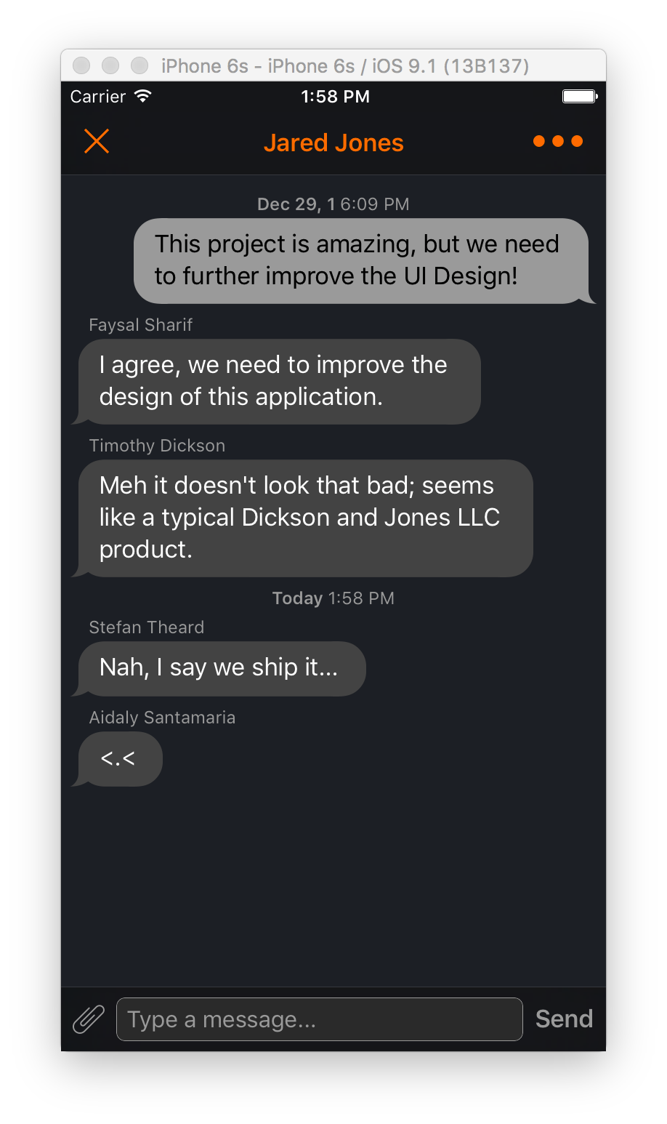
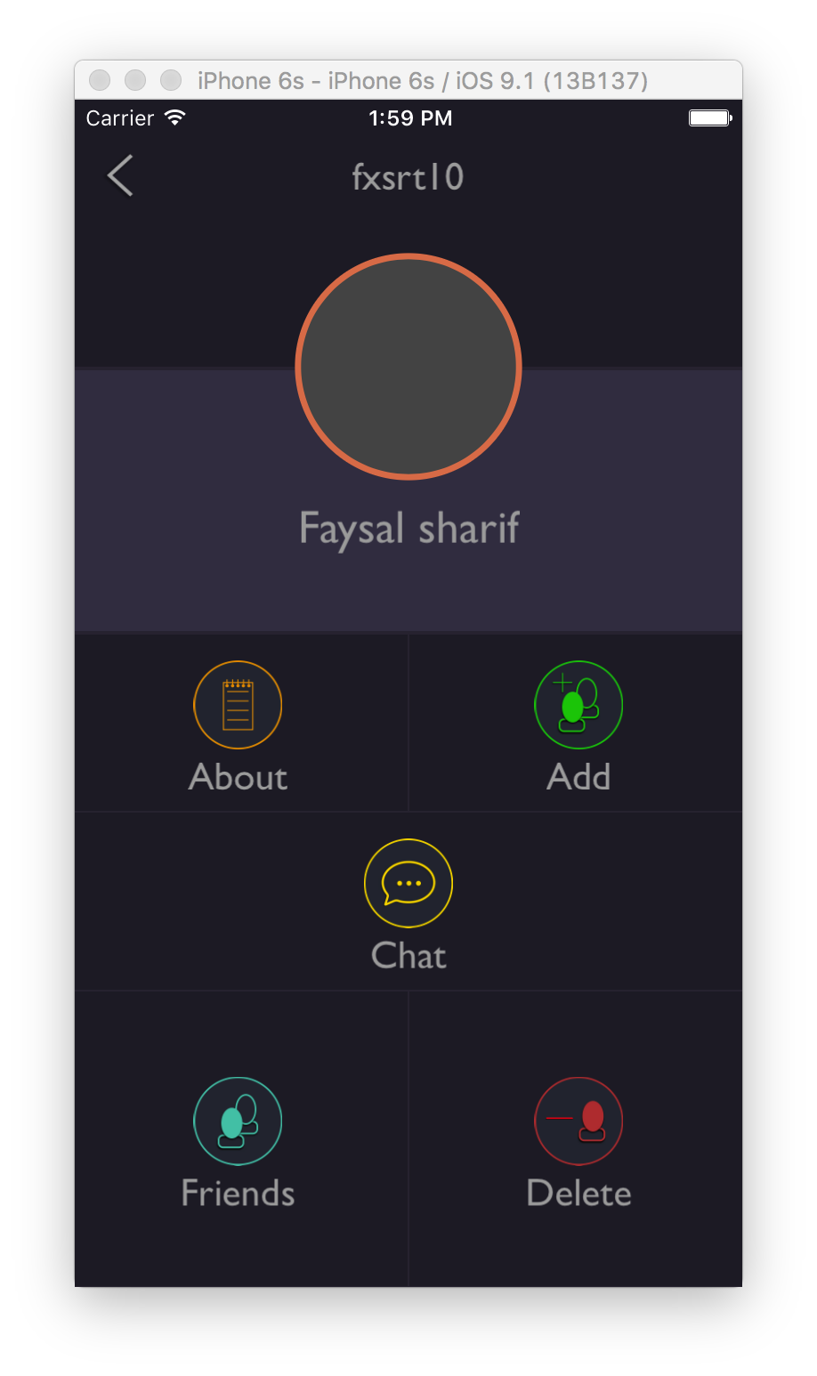
UI

